Slide 1
Infrastructure Management Session - 6
Phalachandra HL
Acknowledgements:
Significant portions of the information in the slide sets presented through the course in the class are extracted from IT Systems Management -Rich Schiesser and other books/Internet. Since these were intended for presentation in the class room for teaching, instructor resources has been requested from the publisher, but not received yet. I would like to sincerely thank, acknowledge and reiterate that the credit/rights remain with the original authors/publishers only

Slide 2
Change Management Process

Slide 3
IT Infrastructure Management
Recap
IT Infrastructure Systems Management, involves managing the IT Services running on the IT infrastructure environment components like the Servers, Disk Storage, DBs, Networks and Desktop environments for providing a stable and responsive IT environment
We discussed on the support needed from executives, organization structure and positioning of the groups which provide these management services, given that one of the KSF are people, we discussed on approaches for staffing and retaining people with required skills and skill levels, the personal and business ethics or lack of it and it’s impact in-terms of legislation and what that drives into organizations
We also looked at how to evolve the services to a customer centric approach and leveraging the best practices using frameworks like ITIL
Then as part of the 12 Key processes which would discuss as part of the course, we discussed on the processes for managing Availability, Performance –Tuning and Production Acceptance process.

Slide 4
IT Infrastructure Management
Recap - 1
In the last session, we looked at the definition and of Performance and Tuning and how it contrasts with other ITSM processes. We then looked at the Process owner characteristics, and then looked at the opportunities which exist for performance management & tuning with respect to 5 major resources in an IT Systems Infrastructure viz. Servers, Disk Storage, Databases, Networks and Desktop computers. We then looked at the assessment worksheets for evaluating the performance and Tuning IT process and metrics which are used for measuring and improving Performance and Tuning process.
We also Production Acceptance process when we looked at the terminologies involved, benefits of production acceptance process, 14 steps involved in the Implementation of production Acceptance Process, process of deployment of new application & a new version of an existing application, and also looked at how deployment process differs from change management and a few case studies which highlighted the production acceptance process

Slide 5
Change Management
Introduction
The next process which we will look at is Change Management which has the most interactions with other disciplines. As part of going through this process we will look at
Introduction to Change Management in terms of the process to control and coordinate all changes to the IT production environment
Components of Change Management
Drawbacks of most Change management processes
Key steps required in developing a Change management process
Emergency changes metrics
Assessing an Infrastructure’s Change Management Process
Measuring and Streamlining the Change Management Process
Change in an IT environment is defined as any modification that could impact the stability or responsiveness of an IT production environment.
Notes:
Dev organizations .. Too many processes for changing by different groups ..
ITSM are projects should not be a new project … common data environment .. Everybody has a different processes ..
https://www.youtube.com/watch?v=LyIdHTn-kuY
Value .. Benefits realization (Quality .. Function/feature..time and money .. Non-functional ..stability..security..Disaster recovery.. Availability .. Production support .. Organizational change.. and control) , Minimizing risk and asset optimization … (mostly resource optimization)

Slide 6
Change Management
Objectives of Change Management
What do you think are the objectives for Change Management
Notes:
Dev organizations .. Too many processes for changing by different groups ..
ITSM are projects should not be a new project … common data environment .. Everybody has a different processes ..
https://www.youtube.com/watch?v=LyIdHTn-kuY
Value .. Benefits realization (Quality .. Function/feature..time and money .. Non-functional ..stability..security..Disaster recovery.. Availability .. Production support .. Organizational change.. and control) , Minimizing risk and asset optimization … (mostly resource optimization)

Slide 7
Change Management
Objectives of Change Management
Value Realization
Responding to changing Business requirements and aligning to Business Goals
Responding to changes in terms of transition to emerging technologies and processes.
(we realize the benefit and would like to change)
I am managing risk and am changing
(Addressing Issues or fixing things with goal of reducing disruption and enhancing effectiveness)
Resource optimization
(Reduction in cost, increase utilization etc.)
All of these while
Ensure changes are properly handled
Ensure all changes to CIs are recorded in the CMS
Notes:
Dev organizations .. Too many processes for changing by different groups ..
ITSM are projects should not be a new project … common data environment .. Everybody has a different processes ..
https://www.youtube.com/watch?v=LyIdHTn-kuY
Value .. Benefits realization (Quality .. Function/feature..time and money .. Non-functional ..stability..security..Disaster recovery.. Availability .. Production support .. Organizational change.. and control) , Minimizing risk and asset optimization … (mostly resource optimization)

Slide 8
Change Management
Introduction
Change Management is the standard process for control and coordination of all changes to an IT production environment, for enabling beneficial change to be made with minimum disruption to IT Services or supporting changes to fix things with goal of reducing disruption and enhancing effectiveness
Change control
Change Control involves requesting, prioritizing and approving of any requested production change, prior to the change co-ordination required for its implementation
All Changes have an impact on the IT environment, and hence need to be assessed for it. Approval and test & Validation process could be different based on the impact
Scope of the impact could be based on the number of users impacted, number of systems impacted, time period impacted, risk involved etc.
If the scope of the change is “No-impact” or “low-impact” with limited scope, the approval process may need approval at a lower level and the Verification may not be as stringent.
If the scope of the change is higher, the change control process could include more formal process of requesting, prioritizing, and approvals
Change co-ordination
Change co-ordination involves collaboration and work together, planning and scheduling the change, Communicating/notifying effectively and implementing the production change requested with minimal impact to the stability/responsiveness of the environment
Notes:
Impact Level
Span or Scope of Impact
Example
High Impact (Global)
Impact to large number of users or business critical service Globally. System down time may be needed.
Introduction of new product, software, topology or feature
High Impact (Local)
Impact to large number of users or business critical service Globally. System down time may be needed.
Large increase in traffic or users, backbone or network routing changes
Medium Impact
Smaller number of users or business service
fewer users affected
Low Impact
Low potential Impact
Adding new standard template modules, providing additional proven access services
No Impact
No user or Service Impact
Adding individual users to network; standard configuration changes like password change, monitoring discovery no expected service/user downtime.

Slide 9
Change Management
Components of Management (Change Control)
The following list describes the different components of change management.
Request: Submit the request for the change to a reviewing board (hard copy or electronic request)
E.g. Tax tables needing to be changed for the new year in a payroll application. Submitted by S/W maintenance programmer to the change advisory board (CAB).
Prioritize: Specify the priority of the change request based on criteria that have been agreed upon.
E.g. In the above example the change is likely to be given a high priority.
Approve: Recommend by a duly authorized review board that the change request be scheduled for implementation or that it be deferred for pending action.
E.g. The change would likely be approved by the CAB pending successful testing of the change.

Slide 10
Change Management
Components of Management (Change Collaboration)
Collaborate: Facilitate effective interaction between appropriate members of support groups to ensure successful implementation; log and track the change. E.g. This may include database administrators who maintain specific tables and end-users who participate in user-acceptance testing.
Schedule: Agree upon the date and time of the change, which systems and customers will be impacted and to what degree, and who will implement the change. E.g. The change will need to occur at the time the new tax tables would go into effect.
Communicate/Notify: Inform all appropriate individuals about the change via agreed-upon means. E.g. This could go out to all users, service-desk personnel (in the event users call in about the change), and support analysts.
Implement: Enact the change; log final disposition; and collect and analyze metrics. E.g. The change would go in and be verified jointly by the implementers and the payroll users.

Slide 11
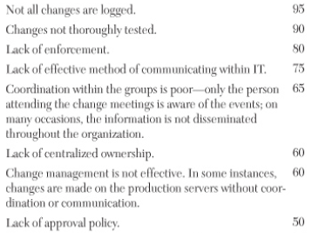
Change Management
Drawbacks of Change Management Processes
Although Change management process has been in existence for a long time, its still one of the processes which are not effectively executed. This could be due to improper process and communication.
IT technicians for whom change is a way of life, see Change control as restricting, delaying or preventing change. They see a formal change management process as non-value-added steps which hinder their day to day activities.
Given these viewpoints, some of the IT organizations implement only part of the change management process in a loose non-robust manner leading to non well managed process.
The following indicate the percentage of occurrence of the following issues

Slide 12
Change Management
Key Steps required in a Change Management Processes
The following 13 steps are required to implement an effective change management process.
Identify an executive sponsor.
Assign a process owner.
Select a cross‐functional process design team.
Arrange for meetings of the cross‐functional process design team.
Establish roles and responsibilities for members supporting the design team.
Identify the benefits of a change management process.
If change metrics exist, collect and analyze them; if not, set up a process to do so.
Identify and prioritize requirements.
Develop definitions of key terms.
Design the initial change management process.
Develop policy statements.
Develop a charter for a Change Advisory Board (CAB).
Use the CAB to continually refine and improve the change management process.

Slide 13
Change Management
Key Steps required in a Change Management Processes : Details - 1
Identification of an executive sponsor:
Change management process requires the support and compliance of every department in the company that could be affected by the change. E.g. Infrastructure groups like Technical services, database administration .. Groups outside the infrastructure like the Application development, Facilities ..
An Executive sponsor must be identified for
Garnering support from and serve as a liaison to other departments
Identifying and assigning a process owner
Providing guidance, direction and resources to the process owner.
Assigning a process owner:
Done by the Executive Sponsor
Process owner needs to assemble and lead teams, facilitate brainstorming sessions, conduct change review meetings, analyze and distribute process metrics, and maintain documentation.

Slide 14
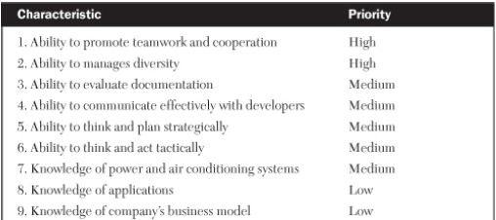
Change Management
Key Steps required in a Change Management Processes : Details - 2
Assigning a process owner (Contd.):
Skill set associated with this role can vary on the organization, but may contain a list as below
Select a Cross-Functional Process Design team:
Since the success of the change management process depends on the support of all of the impacted teams in following the process, one of the key steps would be to identify representatives from these key functional areas and assemble a cross functional team.
The process owner, with support from the executive sponsor, will select and lead this team through this initial change management process

Slide 15
Change Management
Key Steps required in a Change Management Processes : Details - 3
Arrange for Meetings of the Cross-Functional Process Design Team:
A well chosen Cross-Functional team can have scheduling conflicts, absentee members, or misrepresentation at times of critical decision making
It is best to have consensus from the entire team at the outset as to the time, place, duration, and frequency of meetings and then the logistics can be worked out.
Establish Roles and Responsibilities of Change management participant team:
Establishing and ensuring that the members of the Change Management cross functional team are aware of their role and responsibilities
Most importantly the roles of the Sponsor, Process owners, the contributors of the cross functional team (the SMEs) and any others as relevant to the environment
Identify the Benefits of a Change Management Process:
Identifying the benefits of the change management process can help promoting the Change management process well can greatly help in fostering support for the same.

Slide 16
Change Management
Key Steps required in a Change Management Processes : Details - 4
What would you think would be the benefits of a change management process

Slide 17
Change Management
Key Steps required in a Change Management Processes : Details - 4
Identify the Benefits of a Change Management Process (Cont.):
Some common benefits of Change Management process
Visibility: The number and types of all changes logged will show the degree of change activity being performed in each unit to the Change Advisory Board
Communication: The CAB meeting ensures that the information about the key changes, schedules and impacts are communicated
Analysis: Changes that are logged into the access database can be analyzed for trends, patterns and relationships
Productivity: Change information logged could be analyzed for identifying some root causes and elimination of supplicate work for enhancing productivity.
Proactivity: Change analysis can lead to a more proactive approach toward change.
Stability: All of the previous benefits can lead to an overall improvement in the stability of the production environment which can benefit customers and support staff alike
Standardization: As discussed earlier

Slide 18
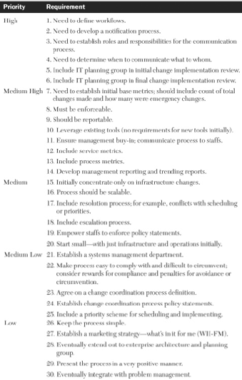
Change Management
Key Steps required in a Change Management Processes : Details - 5
Change metrics to be defined, collected and Analyzed:
Metrics like the types of changes, frequency of changes etc. can be helpful in developing process parameters such as priorities, approvals, and lead times.
Percentage of emergency and planned changes could give the planned state of the environment
Identify and Prioritize Requirements
Identifying the requirements and prioritizing the requirements is essential as there can be constraints on the time, cost and resources.
E.g.

Slide 19
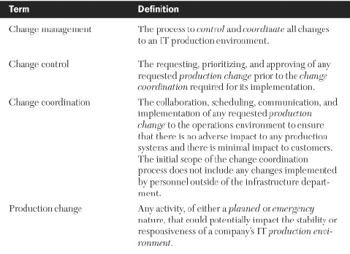
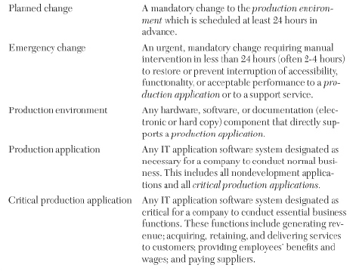
Change Management Key Steps required in a Change Management Processes : Details - 6
Develop Definitions of Key Terms
Need unambiguous usage of the terminologies and hence have to be defined
Some of the terminologies of Change, Change Management, Change Control and Change co-ordination have been defined earlier too

Slide 20
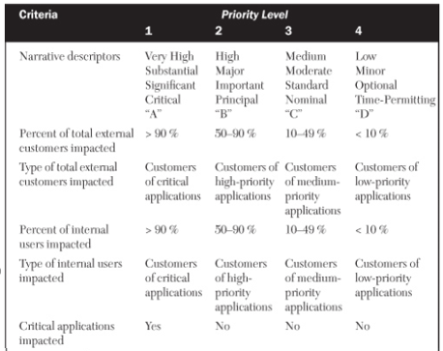
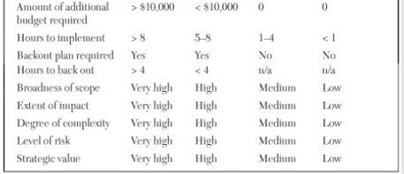
Change Management
Key Steps required in a Change Management Processes : Details - 7
Design the Initial Change Management Process
This is one of the key activities of the cross-functional team. The major deliverables produced in this step are:
A priority scheme : A set of criteria should be identified to distinguish different levels of planned changes for both planned and unplanned changes. The criteria could be
Qualitative like degree of complexity and level of risk
Quantitative criteria like number of internal of external customers impacted, number of hours needed to implement the change.
Impact can be grouped into different levels like 4 levels or 2 levels etc. E.g. Criteria with four level impact based on some of qualitative and quantitative criteria
Notes:
Standard Emergency Normal

Slide 21
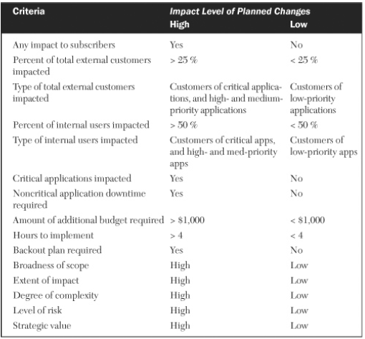
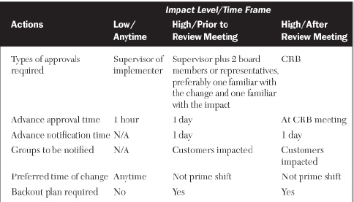
Change Management
Key Steps required in a Change Management Processes : Details - 8
Design the Initial Change Management Process (Cont.)
A priority scheme (Cont.):
E.g. Impact grouped into two levels
Actions to be taken based on the level of change
Action Matrix for planned changes

Slide 22
Change Management
Key Steps required in a Change Management Processes : Details - 9
Design the Initial Change Management Process (Cont.)
2. Actions to be taken based on the level of change (Contd.)
List of actions for emergency change
1. If not an emergency change, then follow the actions in the action matrix for planned changes.
2. Implementer or recovery team rep notifies all appropriate parties, including the support center of the emergency change.
3. Recovery team should initiate recovery action within 2 hours.
4. Recovery team should determine problem status update interval for support center.
5. If status interval is exceeded, recovery team rep updates support center.
6. Support center to notify all appropriate parties of the update.
7. Repeat steps #5 and #6 until problem is resolved.
8. Support center issues final resolution to all appropriate parties.
9. Implementer logs activity as an emergency change.
10. CAB issues final disposition of the emergency change at the next CAB meeting.
11. Change manager records the board’s final disposition of the change into the emergency change request record.

Slide 23
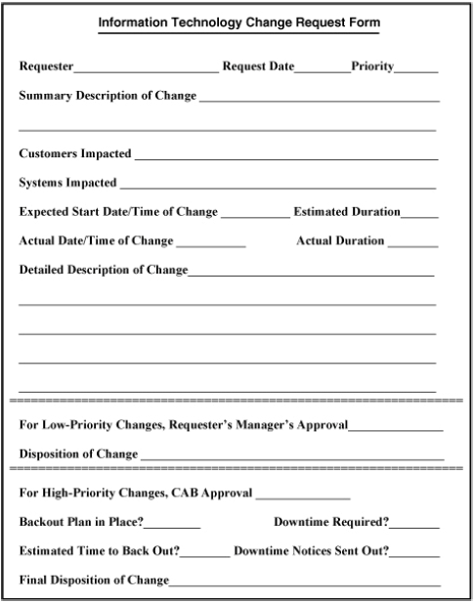
Change Management
Key Steps required in a Change Management Processes : Details - 10
Design the Initial Change Management Process (Cont.)
A change request form
A review methodology
Constitute a Change Advisory Board-CAB to have a formal centralized review and approval mechanism to ensure changes and its impacts are managed by an accountable typically a cross-functional decision-making team, considering the variety of impacts which can arise out of the change.
Periodic (weekly) review schedule of CAB
Metrics
Establish metrics for tracking, analyzing, and trending the number and types of planned and emergency changes occurring every week.
Designing a Roll back or backout process

Slide 24
Change Management
Key Steps required in a Change Management Processes : Details - 11
Develop Policy Statements
Policy statements reflect the philosophy which will be followed by executive management, the process design team and the users and makes the process to be visible and credible
Objectives of policy statements is to have the change management process to be supportable, compliant, enforceable, and accountable
E.g.
All hardware and software changes that could potentially impact the stability or the performance of company X’s IT production environment are to go through the change management process.
The IT change manager is responsible for chairing a weekly meeting of the CAB at which upcoming major changes are discussed, approved, and scheduled; also, the prior week’s changes are reviewed and dispositioned by the board.
All IT staff members and designated vendors implementing production changes are expected to log every change into the current IT tracking database.
The change manager is responsible for compiling and distributing a weekly report on change activity including the trending and analysis of service metrics and process metrics.

Slide 25
Change Management
Key Steps required in a Change Management Processes : Details - 12
Develop a Charter for a Change Advisory Board (CAB)
The first review meeting of the CAB would set up the CAB charter statements like ones as below
(Scope, Desired outcomes, Functioning, Duration and time, Reporting ..)
Scope
Review all upcoming high‐impact change requests submitted to the CAB by the change coordinator Review a summary of the prior week’s changes
Validate that all emergency changes from the prior week were legitimate.
Review and track the status of all planned change requests from the prior week as to impact level and lead time.
Outcome
Approve if appropriate.
Modify immediately (if possible) and approve (as appropriate).
Send back to requester for additional information.
Cancel at the discretion of the board.
Analyze total number and types of changes from the prior week to evaluate trends, patterns, and relationships.
Functioning
Few of the roles may have Veto’s.
Changes will be approved, modified, or cancelled by a simple majority of the voting members present.
Periodicity
CAB will meet every Wednesday from 3 p.m. to 4 p.m. in room 1375.
Reporting
CAB typically is an independent team to begin with
CAB meeting will eventually become part of a systems management meeting at which the status of problems, service requests, and projects are also discussed.
Disputes will be escalated to the senior director of the infrastructure department.
Notes:
The team charter has two purposes. First, it serves as a source for the team members to illustrate the focus and direction of the team. Second, it educates others (for example the organizational leaders and other work groups), illustrating the direction of the team.

Slide 26
Change Management
Key Steps required in a Change Management Processes : Details - 13
Use the CAB to Continually Refine and Improve the Change Management Process
A constant action item in the CAB (Change Advisory Board) meeting would be discuss improvements for the change management process. If any approved by the CAB then should be assigned, scheduled for implementation for follow on meetings.
PTO

Slide 27
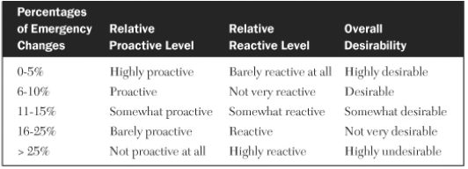
Change Management
Emergency Change Metrics
Emergency change is an urgent mandatory change requiring manual intervention in less than 24 hours (typically to be scheduled ~2-4 hours), to restore or prevent interruption of accessibility, functionality, or acceptable performance to a production application or to a support service
One of significant metrics for change management is the number of emergency changes occurring each week, when compared to the weekly number of high-impact changes and total weekly changes
The degree of emergency change management reflects the proactiveness or reactiveness of the environment. A number of ~15-20% could mean the environment is reactive
Higher percentage of Proactive changes indicates that the changes are thoroughly planned and properly coordinated well in advance.
The number of emergency change metrics trended over time indicates maturity of the process and gives a good indication on the progress towards being proactive.
Notes:
Change Which is adding more value

Slide 28
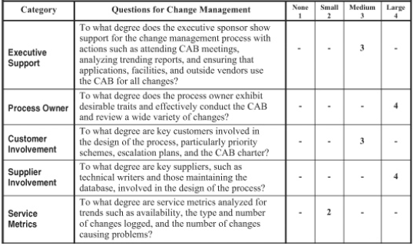
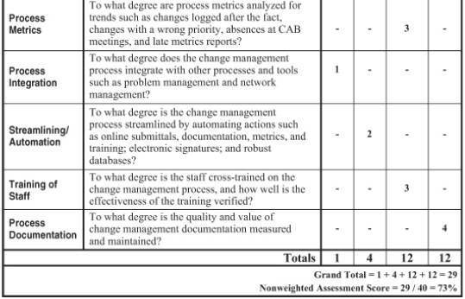
Change Management
Assessing an Infrastructure’s Change Management Process
Continuing with the Worksheet for assessing the overall quality, efficiency, and effectiveness of the performance & tuning process. (without weighing factor)
Quality
Executive support
Process owner
Process documentation
Efficiency
Supplier involvement
Process metrics
Process integration
Streamlining/automation
Effectiveness
Customer involvement
Service metrics
The training of staff
Characteristics within each category is rated on a scale of 1 to 4 . 1 - 4 indicating no presence to a large presence of the characteristic.

Slide 29
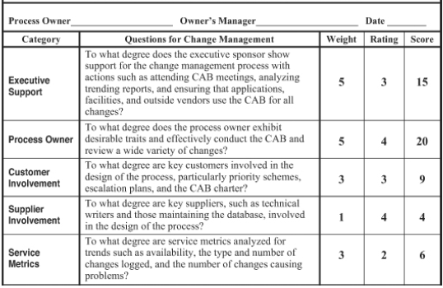
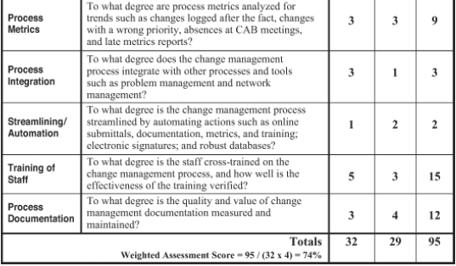
Change Management
Assessing an Infrastructure’s Change Management Process
Worksheet with a weighing factor to assign relative importance provided for a particular category and the worksheet is enclosed.
Maximum Weight – 32
Maximum Rating Value - 4
Maximum Weighted Score
= Max Weight * Max Rating Value Max Weighted Score = 32 * 4
= 128
Weighted Assessment Score
= Total Score/Max Weighted Score
= 95/128 = 0.742188 = ~0.74
= 74%

Slide 30
Change Management
Measuring and Streamlining the Change Management Process
We can measure and streamline the change management process with the help of the assessment worksheet.
We can measure the effectiveness of a change management process by analyzing service metrics such as availability, the type and number of changes logged, and the number of changes causing problems, number of changes which had to be rolled back.
Process metrics like the changes logged after the fact, changes with a wrong priority, absences at CAB meetings, and late metrics reports, help us gauge the efficiency of the process.
Change management process can be streamlined by automating certain actions like changes logged after the fact, changes with wrong priorities, absences at CAB meetings, and late metrics reports etc.

Slide 31
Discussions (Change Management)
How does Change Control and Co-ordination work within your organization
Do you have the same process followed for any change within the organization
Name some of the metrics used with change management process within your organization
What is the ratio of emergency and non emergency changes in your organization

Slide 32
Problem Management Process
BITS Pilani, Deemed to be University under Section 3 of UGC Act, 1956

Slide 33
Problem Management
Topics Covered
The next process which we will look to design and implement is Problem Management. As part of going through this process we will look at
Context of Problem Management
Definition and Scope of Problem Management
Distinguishing Between Problem, Change, and Request (Service Request) Management
Distinguishing Between Problem Management and Incident Management
The Role of the Service Desk
Segregating and Integrating Service Desks
Key Steps (11) to Developing a Problem Management Process
Client Issues with Problem Management
Assessing an Infrastructure’s Problem Management Process
Measuring and Streamlining the Problem Management Process

Slide 34
Problem Management
Introduction
Datacenters today have a large number of complex systems and support diverse set of services. Given this context, problems is bound to occur leading to missing the targeted levels of service, and problem management process supports managing of the variety and volume of these problems.
Problem Management is a process used to identify, log, track, resolve, and analyze problems impacting the IT services
Sophistication of the DB and the Depth of the analysis provides the robustness of the problem management system
Problem Management Variations
End
User
Programmers
System
Admins
Variations | Description
1 | 1-Tier reporting only - Incident Management
2 | 2- Tier Traditional Problem Management (SRM + Specialized Support)
3 | 3-Tier - Escalation Management
4 | Major Service Disruption - Crisis Management
5 | 1-Tier Reporting and Service Request management
6 | All tiers reporting and Service request management
7 | All tiers reporting and both Service request and change management)
trouble call
Problem identified
Service
Desk
Problem DB
Notes:
Blue Screen : Driver, Software Changes, Memory Issues or Display Card

Slide 35
Problem Management
Distinguishing between Problem, Change and Service Request Management
Problem, Change, and Service Request management are three infrastructure processes that are closely related but distinct.
E.g. Change process supporting a change of a DB, could cause a problem to the Backup window as it would then overlap into production time.
Change Management
Problem Management
Service Request Management
Problem Management | Change Management | Service Request Management
Problem with a desktop component E.g. Customer not able to access the network Slow response to online Applications | Addition or modification of any production hardware, software which can impact multiple customers | Responding to an operational service request for a customer from the production hardware. Setting up an email account.
Fix when broke approach | Could be a planned prioritized change or emergency needing mandatory ASAP change | Responding to request for help on an action.
Some of these may be resolved on the phone E.g. accessibility of the network | Add a backup server Add more disk volumes Associated with Priority level x | Change the file permissions of a file etc.
Sometimes Problems (which cannot be resolved) can lead to Change Request

Slide 36
Problem Management
Distinguishing between Problem Management and Incident Management
In some environments Incident and Problem may be used distinctly
Initially all calls are logged in by the Service desk (Tier 1 support) as incidents.
These Incidents with some very initial investigation by the Service operator, if found to be some kind of a request but not a problem, then its serviced and closed by the Service operator as Service request.
If the incident is resolved, with some further investigation and analysis by the Service operator, then the call is closed as an Incident.
If the call could not be resolved at the service desk, then the call is passed on to the Tier 2 (second level) support and designated as a problem. Or if there is a pattern to the incidents, then these incidents could be looked at as a class problem.
Summarily Calls closed by Tier 1 support are categorized as incidents and calls needing Tier 2 support are categorized as problems.
Incident Management : Focus is on timeliness & resolution of the problem/restoration of services with minimum disruption.. Reactive.. Incase of Shared IT I/F .. Business and who else is impacted .. Communication
Problem Management : Focuses on root causing issues & looks for more permanent solutions – Reactive and Proactive -
Notes:
Eg. Car tyre example

Slide 37
Problem Management
Service Desk – Role in Problem Management
Most IT organizations have some type of Service desk as a Service function to offer assistance to end-users.
This may be called Service Desk, Help Desk, Call center, Trouble desk, Technical support or Customer Support Center or Customer Service Center.
Service desk serves as the single point of contact into IT for all users and customers
Service desk is responsible for logging of the calls, classifying them, handling them as best as possible and tracking the calls to completion.
Service desk is the face of Problem management and effects the effectiveness of Problem Management
Service desk is a service function and not a process. The process and function are differentiated as shown.
Function | Process
Has strict organizational boundaries | Goes across organizational boundaries
Involves personnel management Hiring Staff Training staff Evaluating performance Offering career paths Performance Management | Involves process management Process design Process Support Process metrics
E.g. Service Desk | E.g. Problem Management

Slide 38
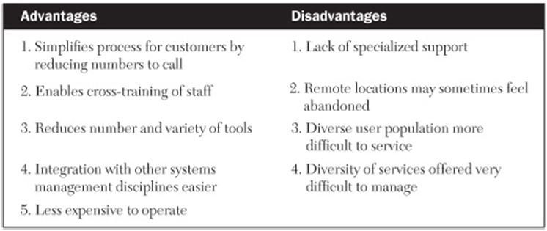
Problem Management
Segregating and Integrating Service Desks
Many companies start and have number of service desks to offer assistance to end-users, as many as the support groups and their IT services. E.g. A bank had ~ 100 separate service desks for IT with one for each application which was in production.
Over time the benefits of integrating service desks gradually prevailed in most instances, although segregated service desks have still a place in Highly diverse user populations, remote locations etc.
Over all the Advantages and disadvantages of Integrating the Service desks as below.
Book-?

Slide 39
Problem Management
Segregating and Integrating Service Desks
Here are the Advantages and disadvantages of a Segregated Service desk is as below.
A compromise hybrid solution is sometimes used in which all IT customers call a single service desk number that activates a menu system. The customer is then routed to the appropriate section of a centralized service desk depending on the specific service requested.
Advantage | Disadvantage
Ability to customize specialized support for diverse applications, customers, and services | Not easier to cross train
If there are too diverse a set of support needing to be provided, a segregated support center can offer better depth of service | Customers will need to call many times or have many service desks to choose from, making it not as effective
 | Increased cost
 | Easier to integrate to different independent processes

Slide 40
Problem Management
Key Steps to Developing a Problem Management Process
The following are the 11 steps which are required for developing a robust problem management process.
Select an executive sponsor.
Assign a process owner.
Assemble a cross‐functional team.
Identify and prioritize requirements.
Establish a priority and escalation scheme.
Identify alternative call‐tracking tools.
Negotiate service levels.
Develop service and process metrics.
Design the call‐handling process.
Evaluate, select, and implement the call‐tracking tool.
Review metrics to continually improve the process.
Notes:
https://www.youtube.com/watch?v=j3aVjckJH1k

Slide 41
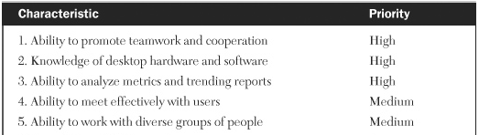
Problem Management
Key Steps to Developing a Problem Management Process - 1
Select an executive sponsor.
An Executive sponsor must be identified for
Bringing together and garnering support from different IT departments and suppliers external to IT and acting as their liaison
Identifying and assigning a process owner
Providing guidance, direction and resources to the process owner.
Assign a process owner.
Done by the Executive Sponsor
Process owner needs to assemble the cross-functional teams for designing and maintaining the problem management process.
Process owner will also need to lead, organize, communicate, team-build, troubleshoot, and delegate effectively.
The recommended skill set for the process owner would be
………..

Slide 42
Problem Management
Key Steps to Developing a Problem Management Process - 2
Assemble a cross‐functional team.
Problem management process involves the participation of several key groups. There could be as many as dozen people as part of the group.
This team is responsible for
Identifying and prioritizing requirements
Establishing the priority scheme
Negotiating internal SLAs
Proposing internal process metrics and external service metrics
Finalizing the overall design of the call-handling process
The groups which are involved can vary between organizations but commonly includes.
Service desk
Desktop hardware support
Desktop software support
Network support
Operations support
Applications support
Server support (includes mainframe and midrange)
Database administration
Development groups
Key user departments
External suppliers

Slide 43
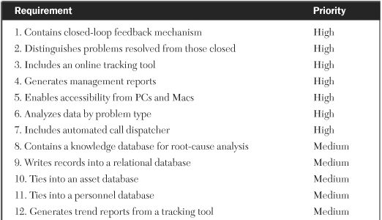
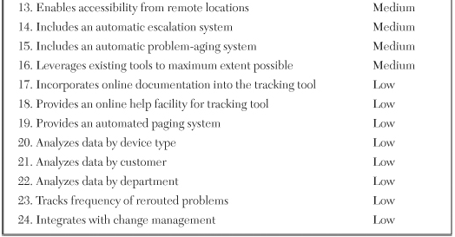
Problem Management
Key Steps to Developing a Problem Management Process - 3
Identify and prioritize requirements for the process
Once the cross functional team has been identified and assembled, the first activity of this team is to identify and prioritize requirements
The team will need to get to consensus on the inclusion and the priority of the requirements for the system. Some of the requirements necessary for building a robust process (like provides metrics, accountability … we will study as a independent module) would be included. Typically dependent on the organization’s current focus and direction beyond building a robust process
………..

Slide 44
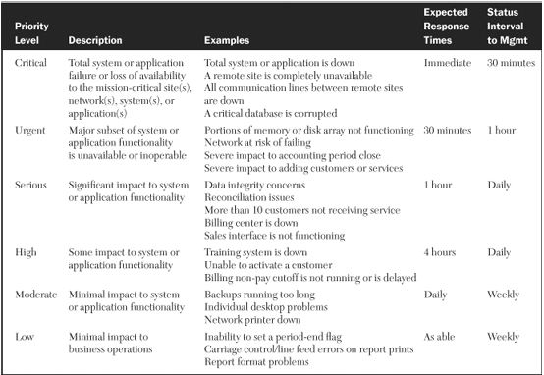
Problem Management
Key Steps to Developing a Problem Management Process - 4
Establish a scheme for Priority and Escalation of the incidents which reach the Service Center
This is the scheme on whose basis you classify and assign priority to the incidents/ problems which land into the service center.
This is also the step where you will establish a scheme which will prescribe how to handle escalations (typically these are high priority difficult to resolve problems)
Typically most organizations attempt to prioritize problems based on severity, impact urgency, and aging.
………..

Slide 45
Problem Management
Key Steps to Developing a Problem Management Process - 5
Identify Call-Tracking Tools with Alternatives to choose from
An effective problem management process revolves around a call-tracking tool, whose requirements are evolved in step 4, and number of alternative tools are identified as part of this step
Companies usually custom build a tool (cheaper and built to the process of the organization) or buy an off the shelf tool (more flexibility with integration capabilities but expensive)
Negotiate Service Levels
External service levels enforceable, and mutually agreed upon by both the customer service department and IT.
Internal service levels should be negotiated with internal level 2 support groups and external suppliers.
Develop Service and Process Metrics
Service metrics should be established to support the SLAs that will be in place with key customers.
The following are some common problem management Service metrics:
Wait time when calling help desk
Average time to resolve a problem at level 1
Average time for level 2 to respond to a customer
Average time to resolve problems of each priority type
Percentage of time problem is not resolved satisfactorily
Percentage of time problem is resolved at level 1
Trending analysis of various service metrics
Notes:
Plutora Test. ...
Airbrake. ...
Backlog. ...
ReQtest. ...
Bugzilla. ...
JIRA. ...
Mantis. ...
Trac.
HP ALM/Quality Center. ...
FogBugz. ...
IBM Rational ClearQuest. ...
Lighthouse. ...
Zoho bug tracker. ...
The Bug Genie
Freshdesk. ...
Salesforce Essentials. ...
Zoho Desk. ...
Wix Answers. ...
Vision Helpdesk. ...
Freshservice. ...
SysAid. ...
LiveAgent.

Slide 46
Problem Management
Key Steps to Developing a Problem Management Process - 6
Develop Service and Process Metrics (Cont.)
The following are some common problem management Process metrics:
Abandon rate of calls
Percentage of calls dispatched to wrong level 2 group
Total number of calls per day, week, month
Number of calls per level 1 analyst
Percentage of calls by problem type, customer, or device
Trending analysis of various process metrics
Design the Call-Handling Process
The entire cross-functional team will need to design this.
It dictates how problems are first handled, logged, analyzed and communicated
This will also indicate how they might be handed off to level 2 for resolution, closing, and customer feedback
This will also design how the proactive calls will be selected
Evaluate, Select, and Implement the Call-Tracking Tool
Alternative call-tracking tools are evaluated by the cross-functional team to determine the final selection.
The selected tool is then implemented
In the initial phases, the tool is passed through a small subset of calls to pilot the implementation.

Slide 47
Problem Management
Key Steps to Developing a Problem Management Process - 7
Review Metrics to Continually Improve the Process
All service and process metrics should be reviewed regularly to spot trends and opportunities for improvement.
This usually becomes the ongoing responsibility of the process owner
Opening of a problem is a critical activity of Problem Management
Properly opened tickets can lead to quick closing of problems or to be forwarded to the appropriate teams for a timely resolution.
Infrastructures with especially robust problem management processes tie in their call-tracking tool with both an asset management database and a personnel database. The asset database allows call agents to view information about the exact configuration of a desktop and its problem history. The personnel database allows agents to learn the caller’s logistics and their recent call history.
Closing of a problem
Resolving of a problem is closure of the problem from the IT service personnel perspective. This gets closed when the customer validates the resolution.

Slide 48
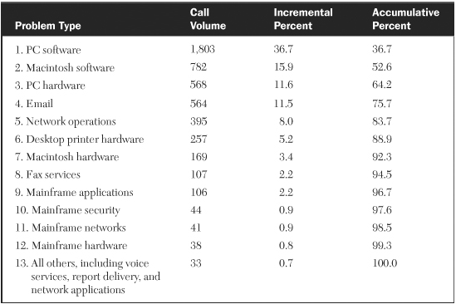
Problem Management
Key Steps to Developing a Problem Management Process - 7
Review Metrics to Continually Improve the Process (Contd.)
Analyzing a variety of trending data can help to continually improve the problem management process.
This data may concern the types of problems resolved, the average time it took to resolve, devices involved, customers involved, and root causes
E.g. Monthly distribution of typical service desk problem types
Observations:
Increment % indicates the % distribution of the calls
This can be grouped for meaningful takeaways. e.g. 92.3% are desktop related issues
This can be used to formulate action plans to address as part of continuous improvement

Slide 49
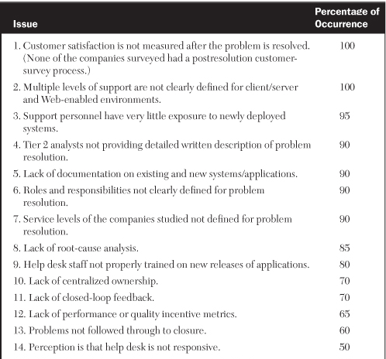

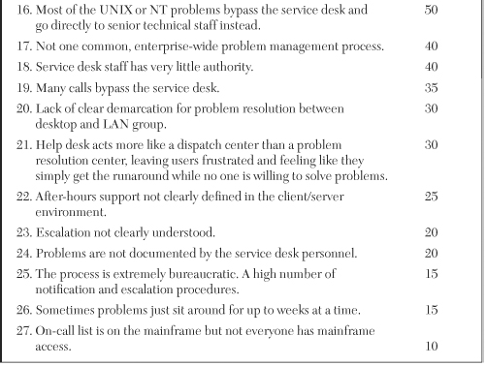
Problem Management
Client Issues with Problem Management
Results from a survey of infrastructure managers and senior analysts on what they believed were the greatest exposures with their current problem management processes.

Slide 50
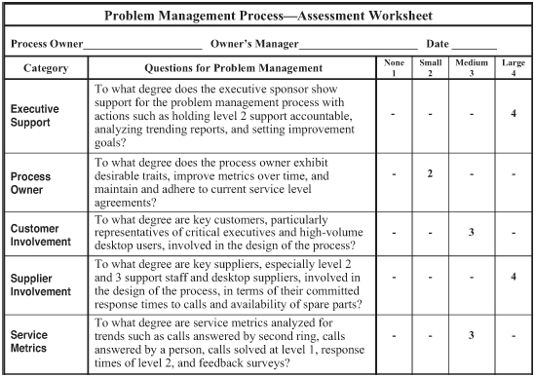
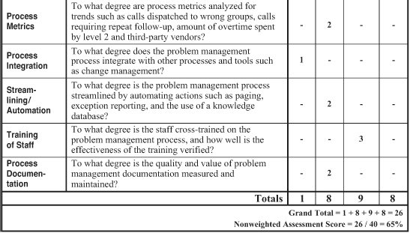
Problem Management
Assessing an Infrastructure’s Problem Management Process
As discussed, this worksheet presents a quick-and-simple method for assessing the overall quality, efficiency, and effectiveness of a problem management process
Quality
Executive support
Process owner
Process documentation
Efficiency
Supplier involvement
Process metrics
Process integration
Streamlining/automation
Effectiveness
Customer involvement
Service metrics
The training of staff
Characteristics within each category is rated on a scale of 1 to 4 . 1 - 4 indicating no presence to a large presence of the characteristic.

Slide 51
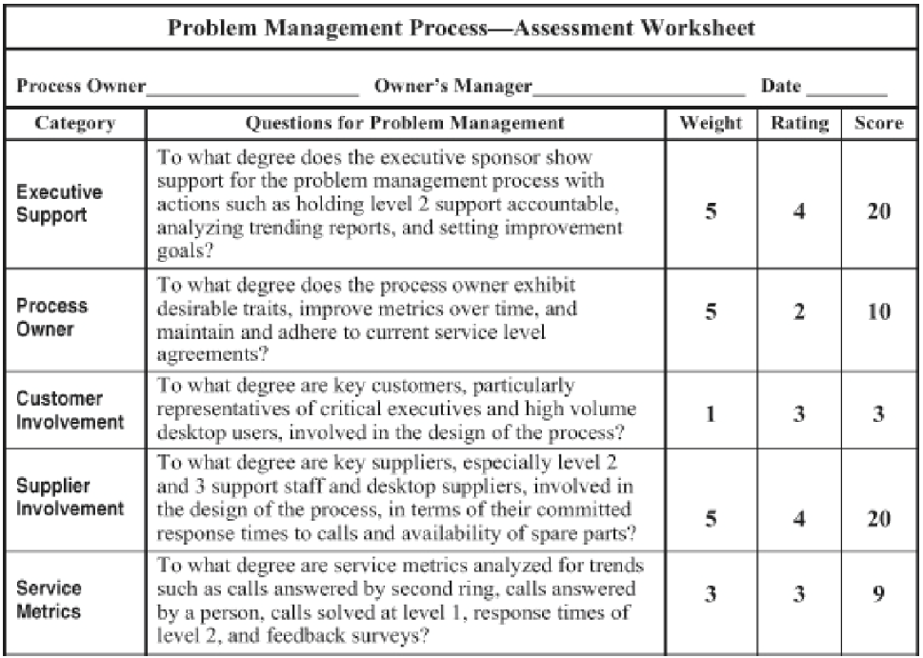
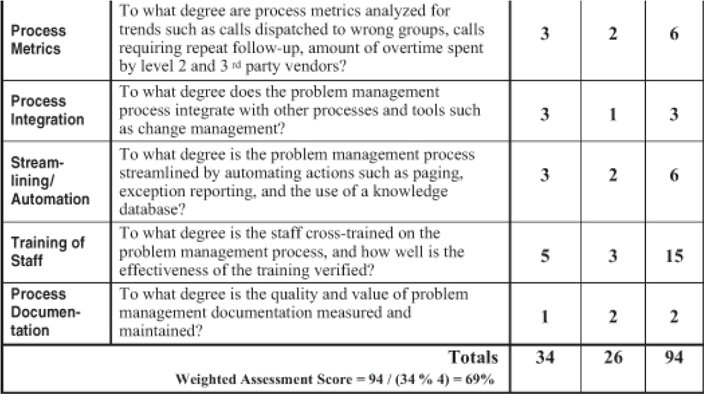
Problem Management
Assessing an Infrastructure’s Problem Management Process
Worksheet with a weighing factor to assign relative importance provided for a particular category and the worksheet is enclosed.
Maximum Weight – 32
Maximum Rating Value - 4
Maximum Weighted Score
= Max Weight * Max Rating Value Max Weighted Score = 34 * 4
= 136
Weighted Assessment Score
= Total Score/Max Weighted Score
= 94/136 = 0.6911 = ~0.69
= 69%

Slide 52
Problem Management
Measuring and Streamlining the Problem Management Process
We can measure and streamline the problem management process with the help of the assessment worksheet.
We can measure the effectiveness of a problem management process with service metrics such as calls answered by the second ring, calls answered by a person, calls solved at level 1, response times of level 2 and feedback surveys.
We can also look at the Process metrics—such as calls dispatched to wrong groups, calls requiring repeat follow-up, amount of overtime spent by level 2, third-party vendors etc. which help us gauge the efficiency of this process.
We can streamline the problem management process by automating actions such as escalation, paging, exception reporting, and the use of a knowledge database.

Slide 53
Discussions (Problem Management)
How is your support levels structured in your organization?
Is your Service desk integrated or segregated and why?
Is Service desk a process or a function in your organization
Name some of the metrics used with problem management process within your organization

